Slide 1
DTS205TC High Performance Computing
Lecture 5 Network Topology and MPI
Di Zhang, Spring 2024

Slide 2
Section
Networks inside Data Center

Slide 3
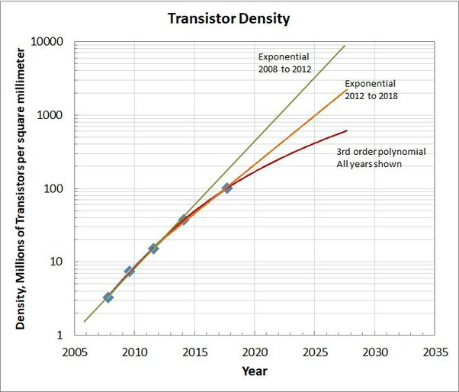
Motivation of Parallel Computing
The failure of Moore's Law
A single processor can no longer be faster. How to design the architecture so that multiple processors can cooperate to shorten the running time?

Slide 4
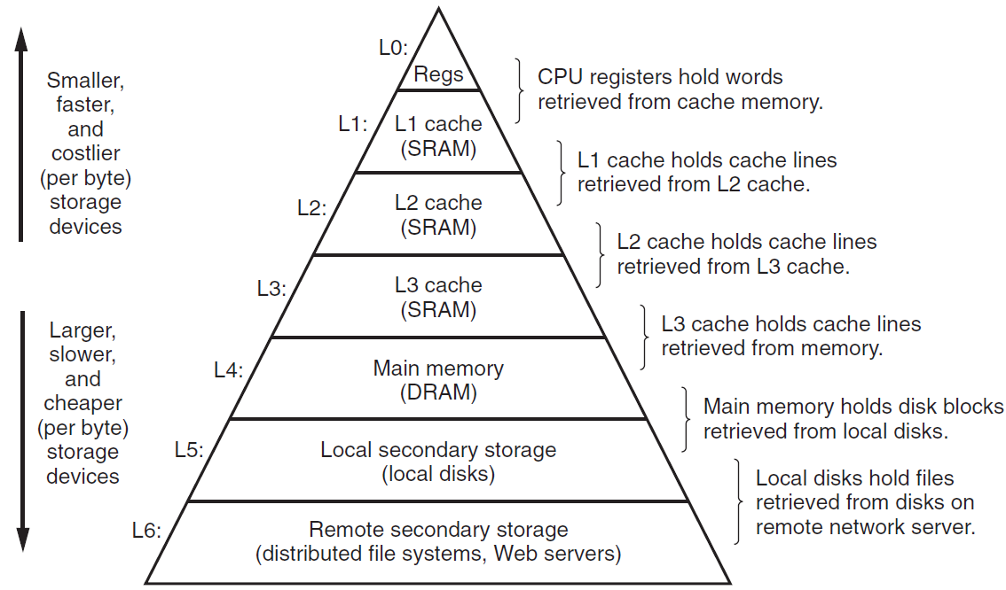
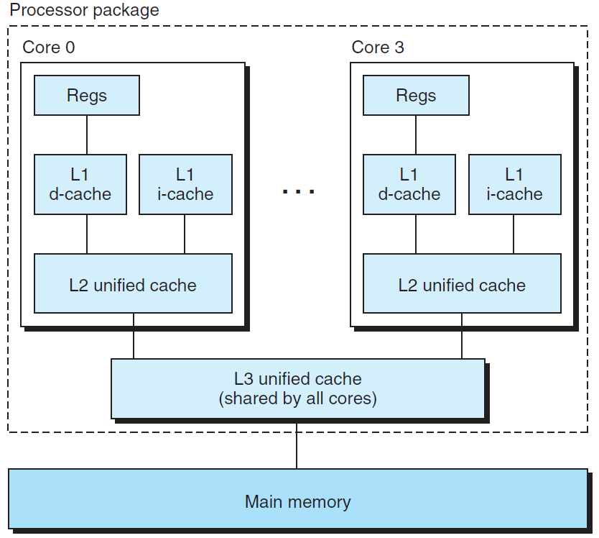
Multi-core solution
Level of Sharing
Architectural choice: depends on what level you want multiple processors to share ‘storage’
Influencing factors:
Performance: We want multiple processors to be as close together as possible to reduce synchronization latency Cost: Integrating too many cores in a limited space can be expensive, and even impossible

Slide 5
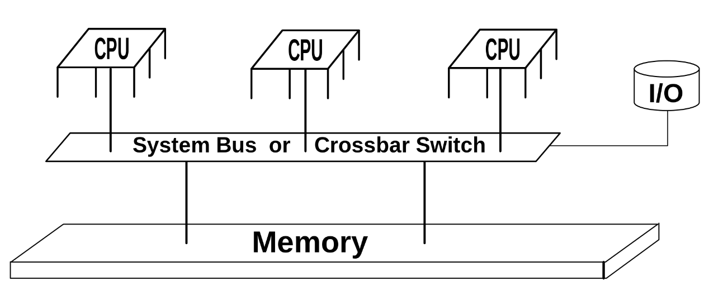
Shared Memory
Level of Sharing
Pros: Parallelism is easy to implement because the data synchronization/messaging process is implicit Programming Model: OpenMP Cons: There are still scalability problems, and the number of CPUs cannot be too large

Slide 6
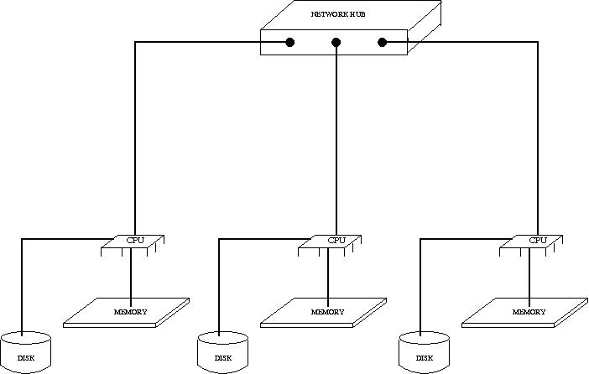
Distributed Memory
Level of Sharing
Advantages: Can scale to very large scales, but the network topology has a large impact on performance Programming Model: MPI
Disadvantages: Messaging must be handled explicitly, with the understanding of network topologies; complex to develop

Slide 7
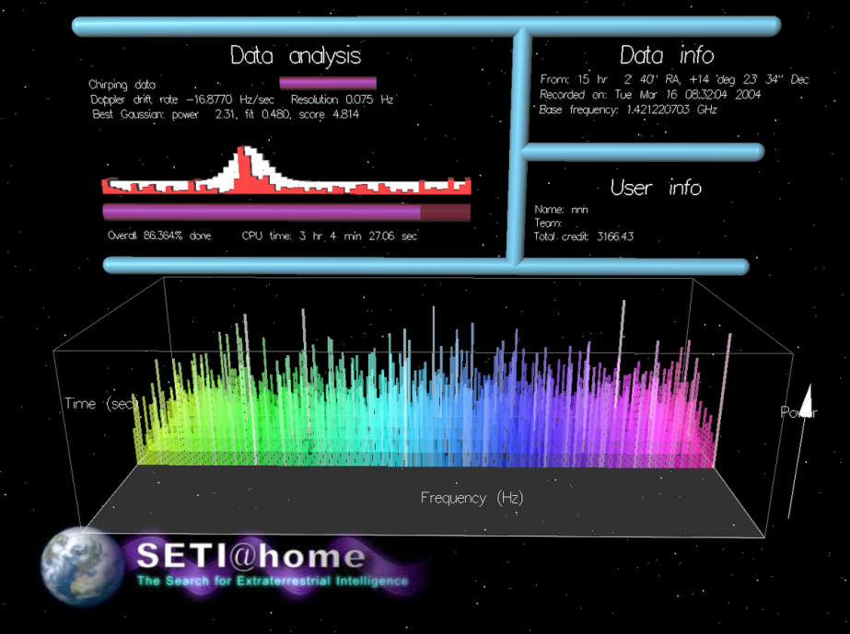
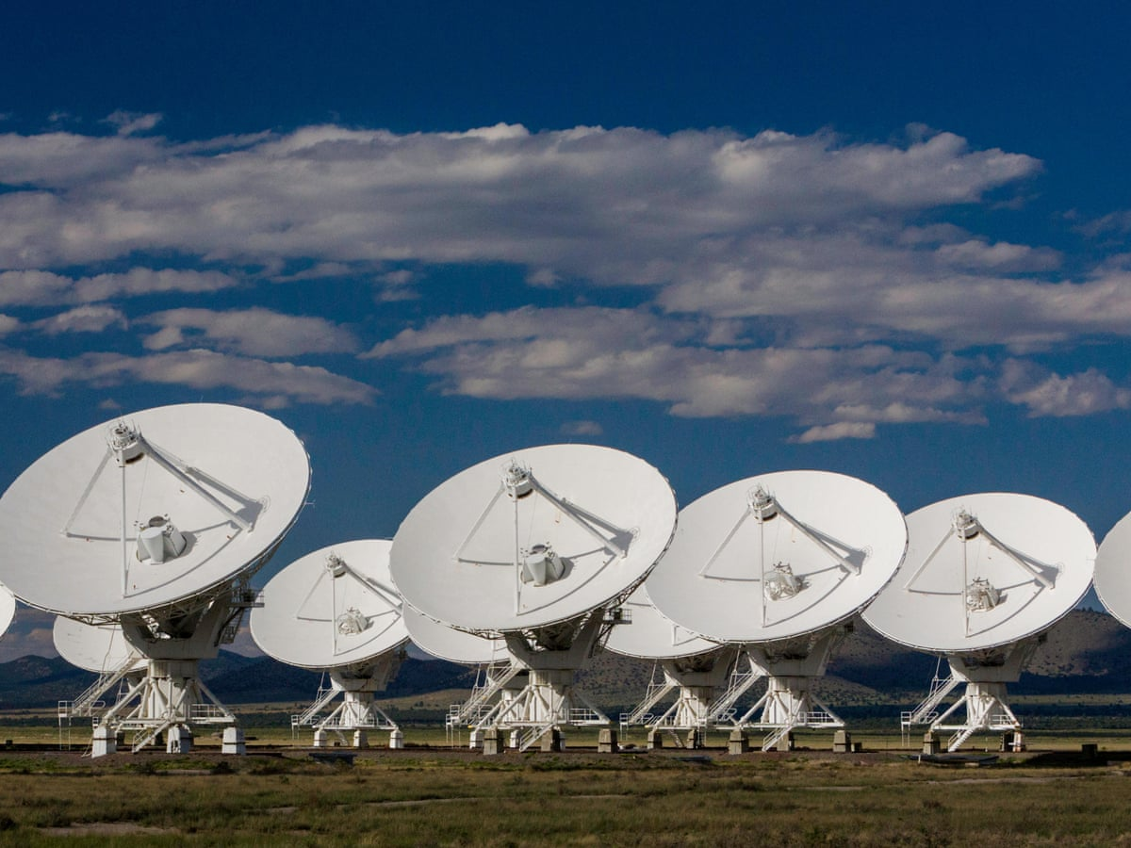

Example: the ‘Slowest’ HPC
Search Alien Civilization, using volunteer PCs on the internet
Found nothing…
Fermi Paradox

Slide 8
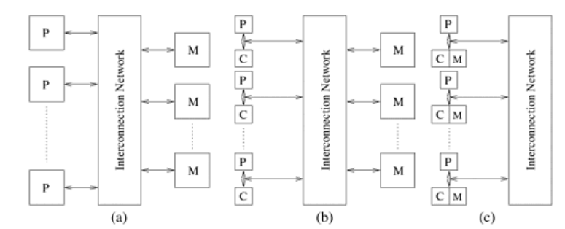

Q: Can we have a global memory model on clusters?
It is possible, yet not very popular:
A) UMA (Uniform memory access)
B) COMA (Cache-only memory architecture)
C) NUMA (Non-uniform memory access)
-> Easy to program, but not easy to tune
根据英特尔实验室声明 [2] The Future of Many Core Computing: A tale of two processors
，共享内存模型最初需要减少应用程序进程并行化的编程工作量，但它会消耗更多时间进行调试和优化。同时，分布式内存模型需要更多的并行化工作，但最终需要缩短调试和优化的时间，从而缩短应用程序交付的延迟。
Memory Array

Slide 9
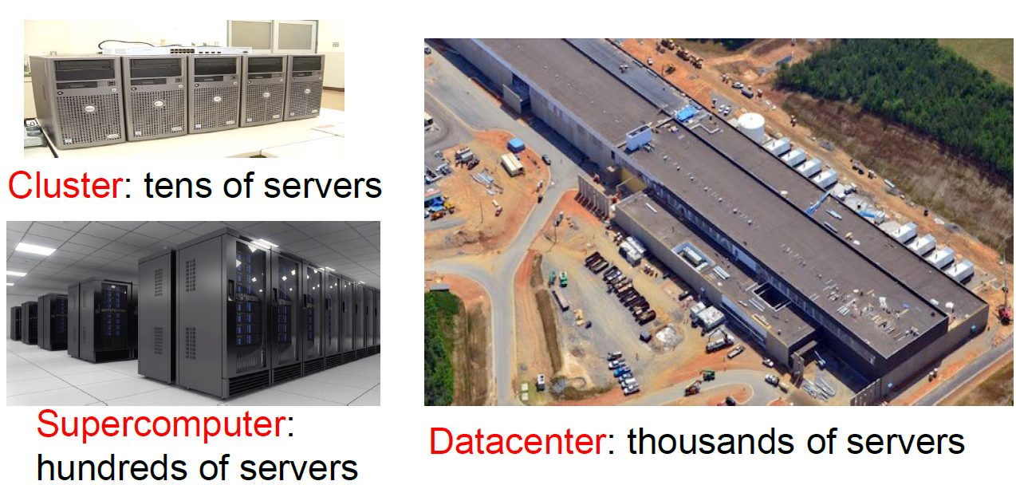
Example of clusters
To balance between cost and performance:
Generally, within a single node, a shared memory is used; Between nodes, networks are used

Slide 10
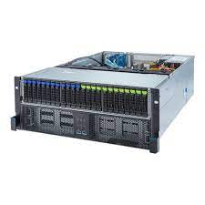
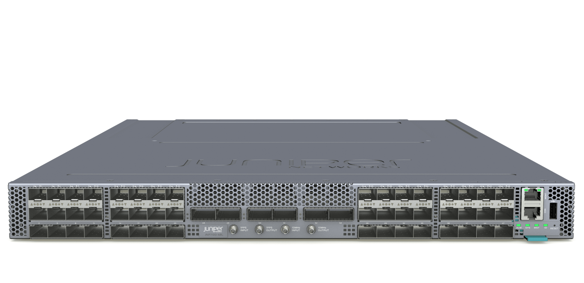
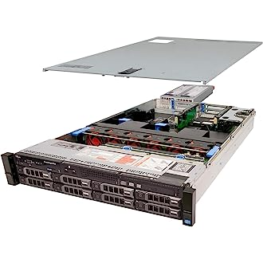

Interlude: appearance
Network Router
Storage
Server
Why do all these devices look similar?
Easy to install uniformly on the rack!

Slide 11
Datacenter networks: elements
Border routers
connections outside datacenter
Tier-1 switches
connecting to ~16 T-2s below
…
Tier-2 switches
connecting to ~16 TORs below
…
…
…
…
Top of Rack (TOR) switch
one per rack
40-100Gbps Ethernet to blades
…
…
…
…
Server racks
20- 40 server blades: hosts

Slide 12
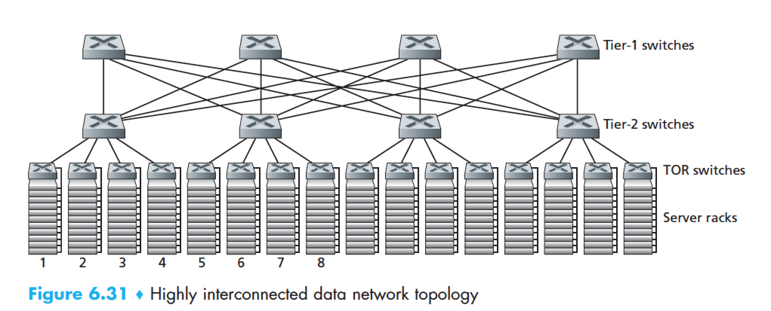
Datacenter networks: multipath
rich interconnection among switches, racks:
increased throughput between racks (multiple routing paths possible)
increased reliability via redundancy
9
10
11
12
13
14
15
16
two disjoint paths highlighted between racks 1 and 11

Slide 13
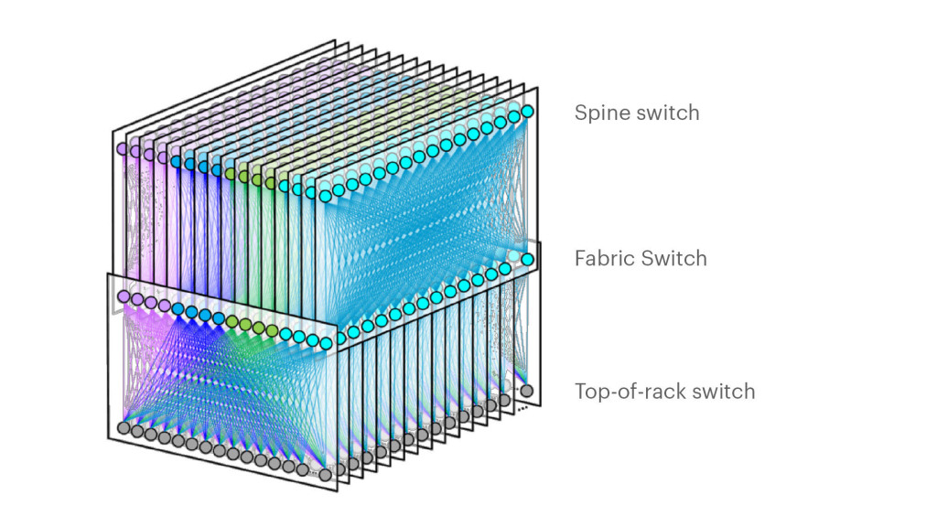
Example
Facebook F16 data center network topology:
https://engineering.fb.com/data-center-engineering/f16-minipack/ (posted 3/2019)

Slide 14
目录
Network topology

Slide 15
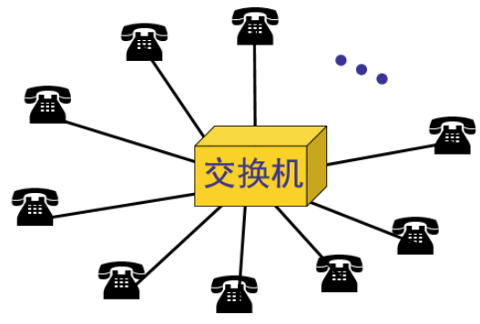

Topology of usual networks
Switch
Switch*
Switch
Switch
Topology
describes how elements of a set relate spatially to each other (wiki)
Star: The simplest structure (* -- linked by a switch with an internal bus)
Tree: Direct contact between two leaves will be slow. For general needs, such as surfing Web, direct contact is rarely required, but it is not for HPC.

Slide 16
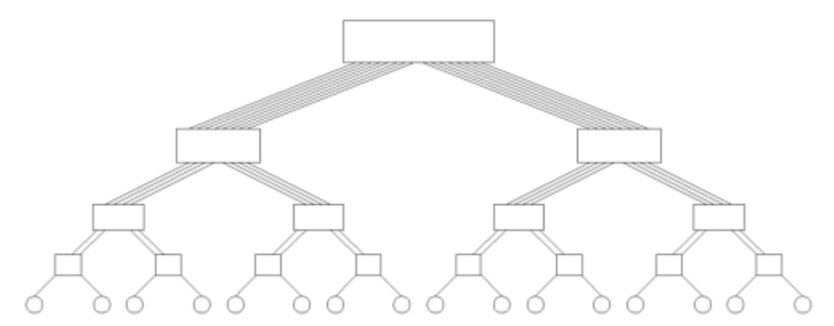
Other possible network structures
Linear
Loop
Fat Tree
Fully Connected
2-D mesh
2-D wraparound mesh
3-D mesh
Balance between cost and performance:
More connections always make communication faster
The higher the number of connections, the higher the cost
Obviously, some structures look more “reasonable” and “connected” than others
How to quantify this concept?

Slide 17
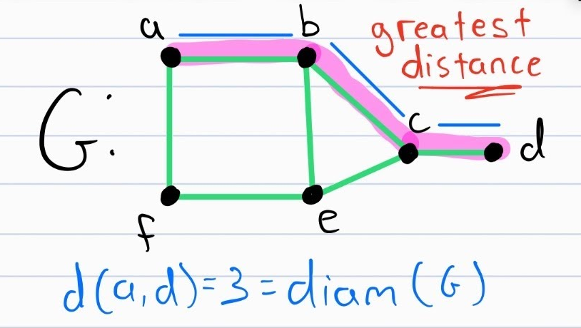
Network performance metrics
Network Diameter: The longest distance between any two nodes in a network.
The larger the diameter, the greater the hop count to complete the communication at the farthest two points, which can easily lead to high latency.

Slide 18
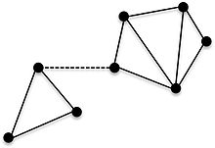
Network performance metrics
Conn=1
Connectivity: The minimum number of arcs that need to be removed to divide a network into two non-connected networks.
Low connectivity, easy to form congestion in some paths, worsening the overall bandwidth and latency.

Slide 19
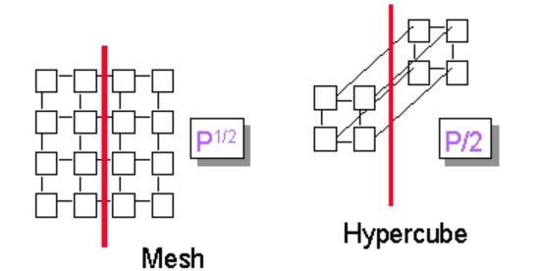
Network performance metrics
Bisection Width: The minimum number of edges that must be removed for cutting network into two equal parts.
On average, it measures how easy it is to send data from one side to the other. This indicator relates to the effectiveness of global communications.

Slide 20
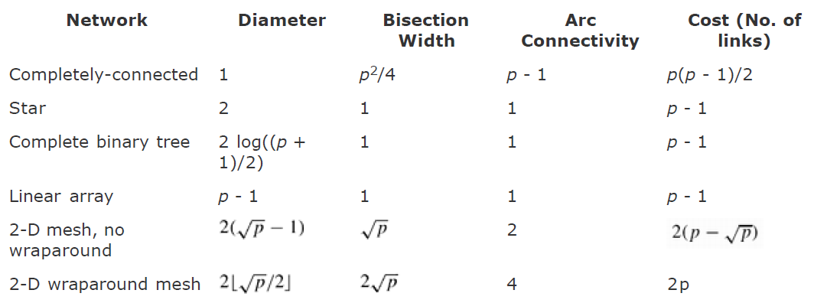
Features of some networks
Minimize
Maximize
Maximize
Minimize
Looks better!
A summary of the characteristics of various static network topologies connecting p nodes.
The key of design lies in finding the optimal connection under the constraint of cost.

Slide 21
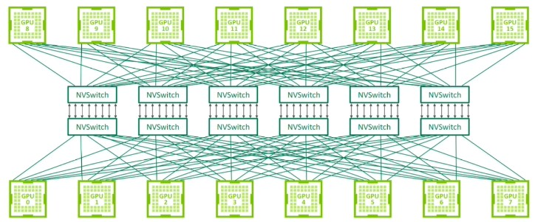
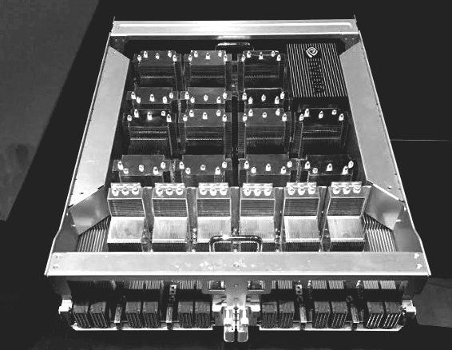
Example: Fat-Tree
GPU Server: NVIDIA’S DGX-2 SYSTEM PACKS

Slide 22
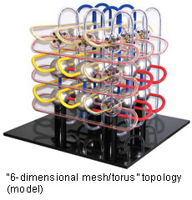
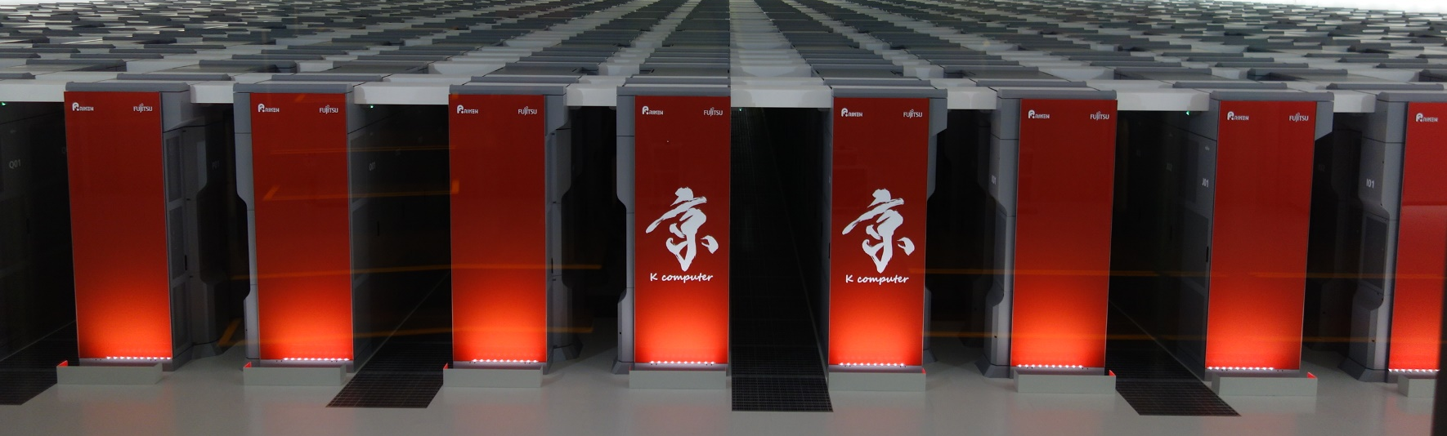
Example: 6D wraparound mesh
K-computer
80,000 compute nodes; 640,000 cores

Slide 23
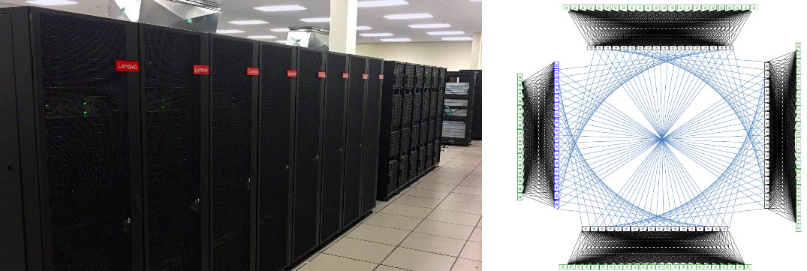
Example: Dragonfly: interconnected fat-trees
Niagara supercomputer

Slide 24
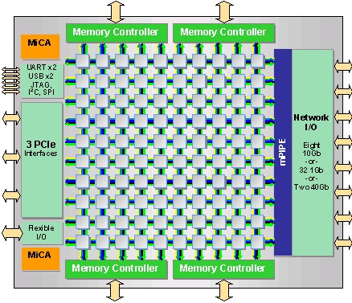
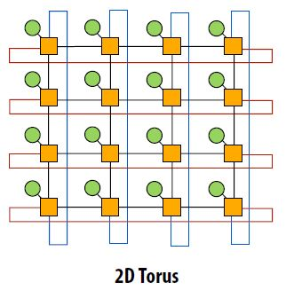
Example: 2D wraparound mesh
Many-core CPU: Tilera TILE-Gx, consists of a mesh network of up to 100 cores

Slide 25
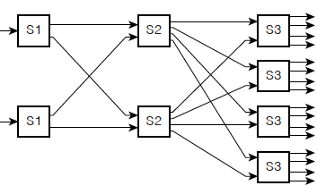
Example: Multiple Fat tree
Cisco CRS router: up to 100’s Tbps switching capacity
fabric plane 0
fabric plane 1
fabric plane 2
. . .
. . .
fabric plane 3
. . .
. . .
fabric plane 4
. . .
. . .
fabric plane 5
. . .
. . .
fabric plane 6
. . .
. . .
fabric plane 7
. . .
. . .
. . .
. . .
. . .
. . .
8x8 multistage switch
built from smaller-sized switches
This is a fat tree!

Slide 26
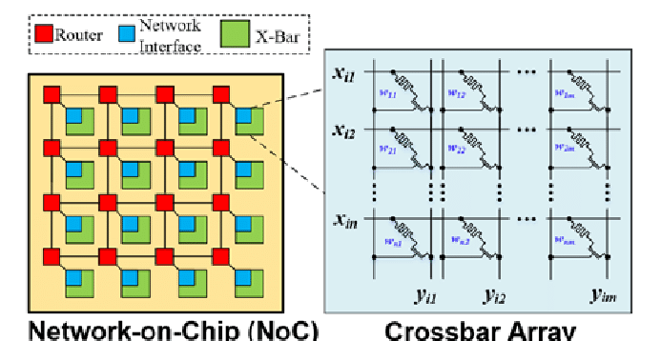
Further Reading：Dynamic networking
Dynamic networking
Switching the connection structure takes time, but it can be fully adapted to the needs of algorithms
Usually more expensive, and less scalable
Notes:
片上网络 （NoC） 和交叉阵列的结构 |下载科学图表 (researchgate.net)

Slide 27
Section
Review of MPI

Slide 28
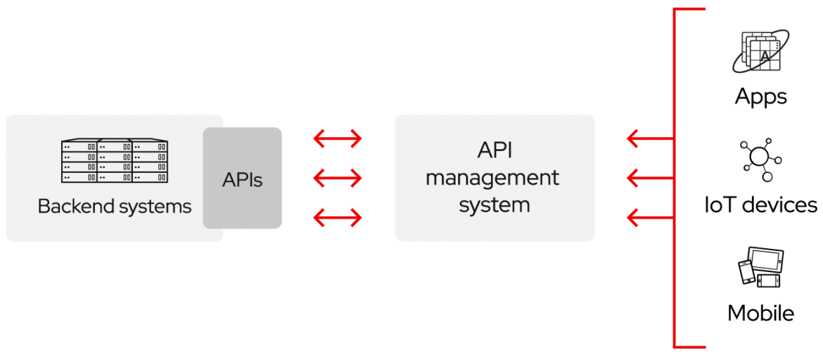
The MPI is an API
API (Application Programming Interface)
An API is a way for two or more computer programs to communicate with each other.
A document or standard that describes how to build or use such a connection or interface is called an API specification.
A computer system that meets this standard is said to implement or expose an API. The term API may refer either to the specification or to the implementation.

Slide 29
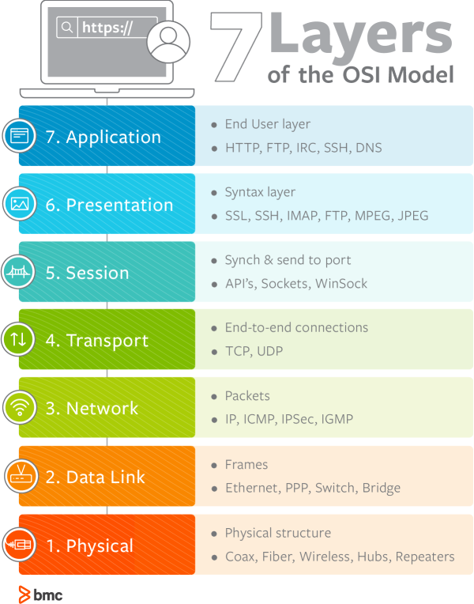
MPI
Message Passing Interface (MPI) is a standardized and portable message-passing standard designed to function on parallel computing architectures.
Although MPI belongs in layers 5 of the OSI Reference Model, implementations may cover most layers. If without support from hardware, the socket programming can be used to implement that.
MPI is language-independent, portable and light-weighted.
Currently we use MPI-3.1 (published in 2015) and its Python library: MPI4py
Notes:
The advantages of MPI over older message passing libraries are portability (because MPI has been implemented for almost every distributed memory architecture) and speed (because each implementation is in principle optimized for the hardware on which it runs).

Slide 30
The core functions of MPI
Communication
One-to-one (blocking/non-blocking) – This is the only part supported directly by the socket programming Collective
Global communication, including broadcast, gather, and scatter; Global reduction, including sum, max, min, etc. Synchronization, including Barriers, etc.;
One-Side
Topology Process-hardware mapping relationship
The concerns of MPI: on the one hand, to meet the algorithms’ requirements, on the other hand, to give hardware the chance of optimization.
Notes:
共享变量
其他
控制发送细节（粒度）
在普通集群上，这些功能通过tcp，也能实现，不过在专用集群上，这些可以通过专用硬件实现。提供了驱动。

Slide 31
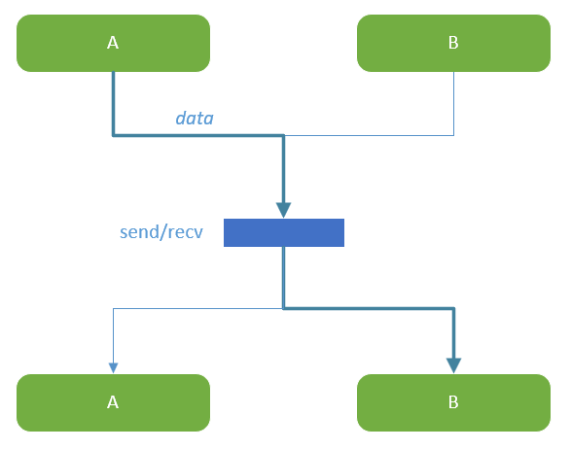
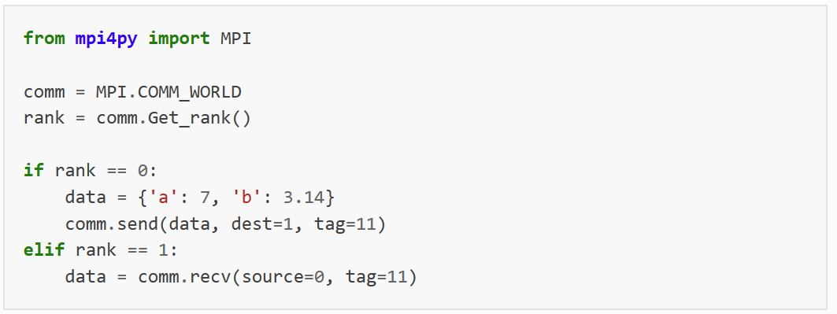
Point-to-point (blocking)
Note: recv can specify no source, that is, it can accept messages from any source

Slide 32
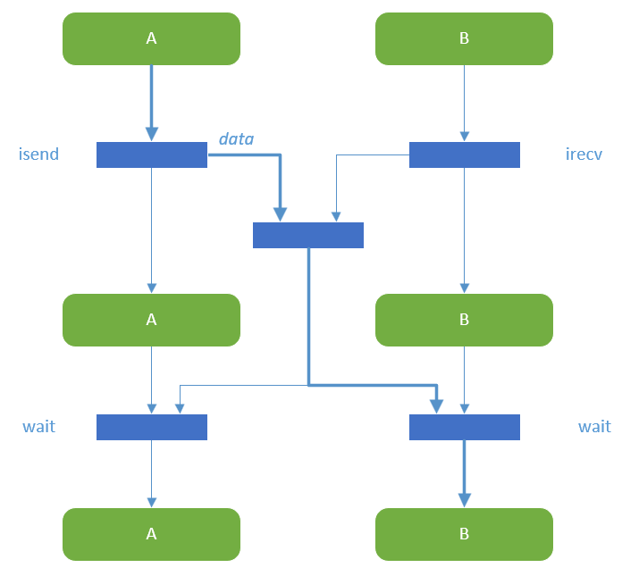
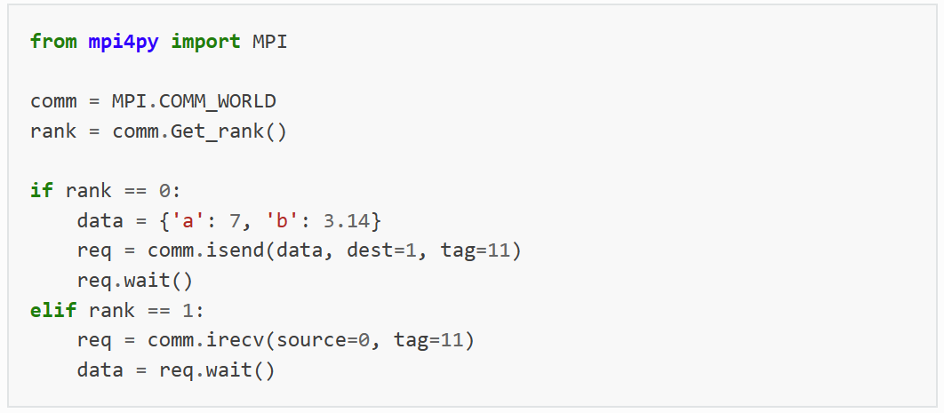
Point-to-point (non-blocking)
Note: test can be used instead of wait to query the state of comm. without blocking

Slide 33
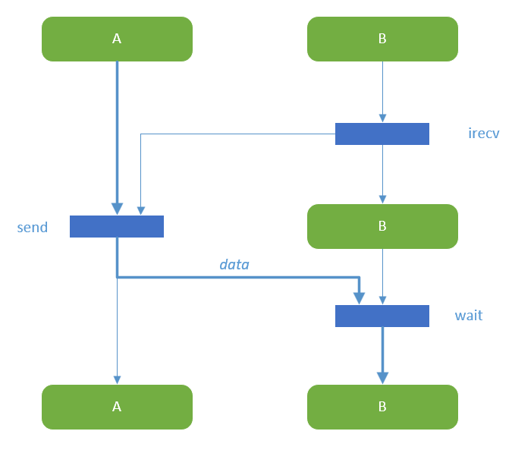
Blocking send + non-blocking receive

Slide 34
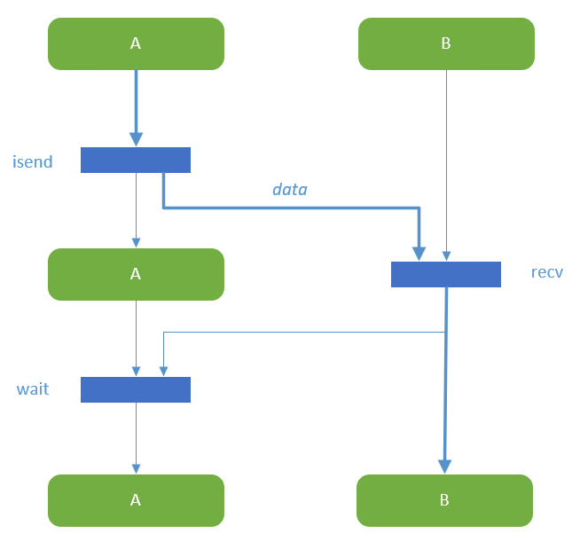
Non-blocking send + blocking receive

Slide 35
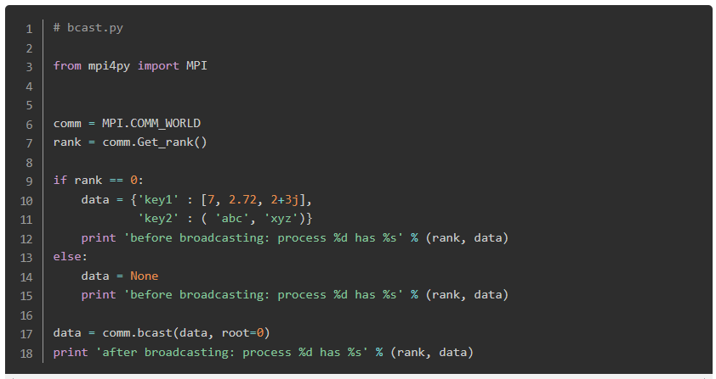
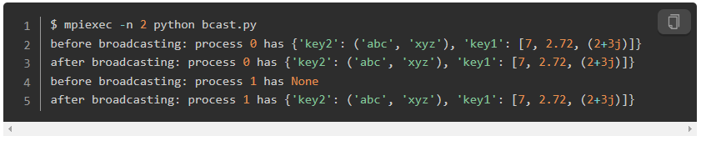
Broadcast
A broadcast operation copies data from the root process to all other processes in the same group. Example: configurations, small inputs, …

Slide 36
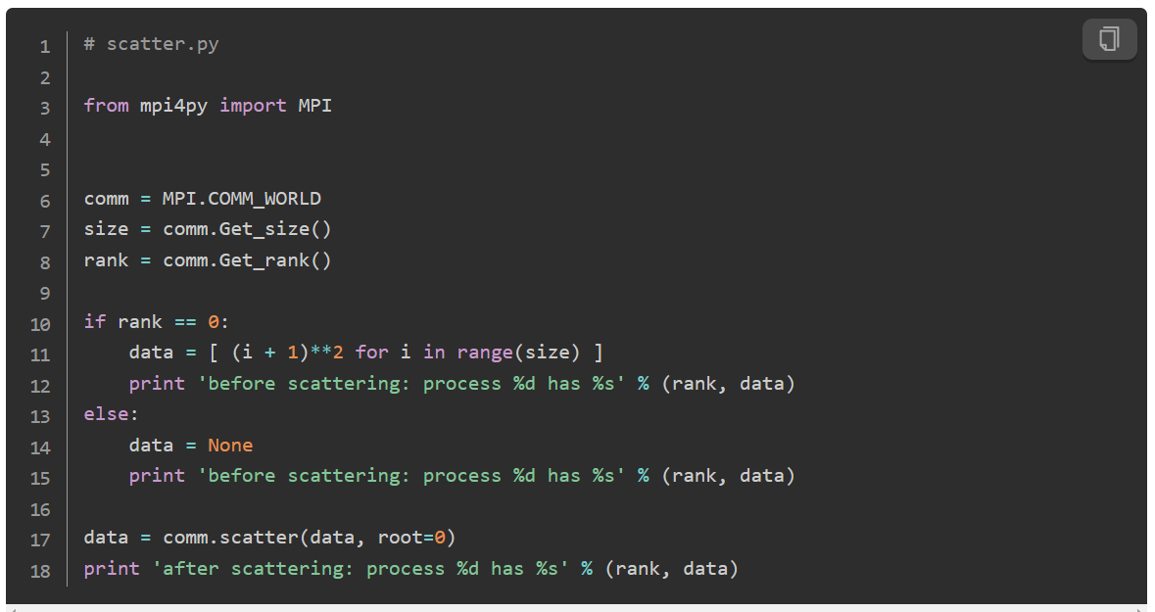
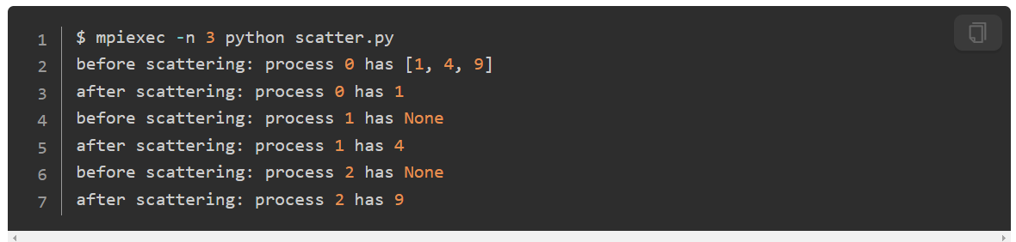
Scatter
Scatter disperses different messages from the root process to other processes in the group.
Example: large inputs

Slide 37
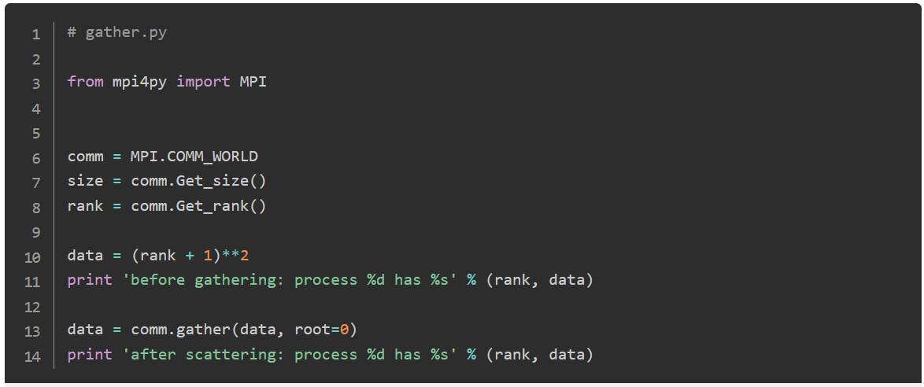
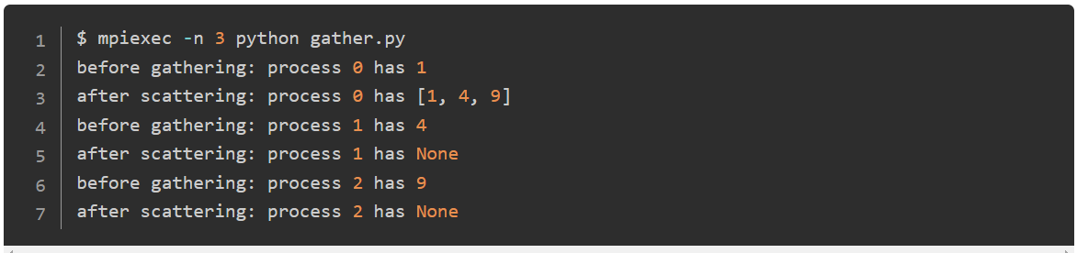
Gather
Gather is the reverse of Scatter, where the root process collects different messages from other processes and puts them into its own receive buffer.
Example: Intermediate results

Slide 38
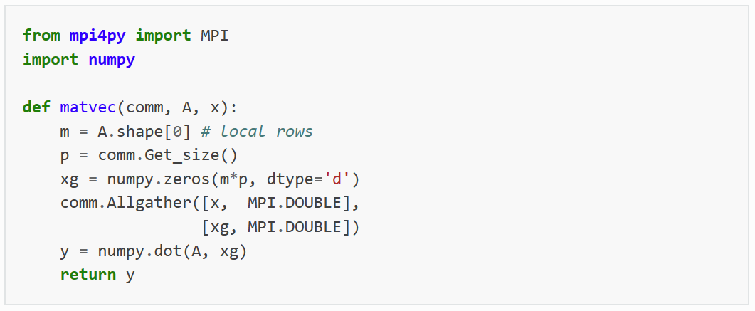
Allgather
Xg is a large vector residing on different nodes
It concatenates data from the send buffers of all processes in the group and sends them to the receive buffers of all processes.
Example: concatenate local results

Slide 39
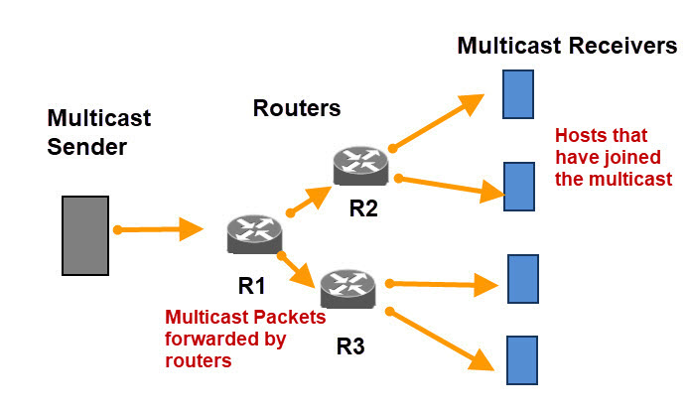
Hardware/protocol support
Link Layer
If nodes happen to be connected to one branch of a tree, the broadcast message can be sent only once
Network Layer
IP Multicast

Slide 40
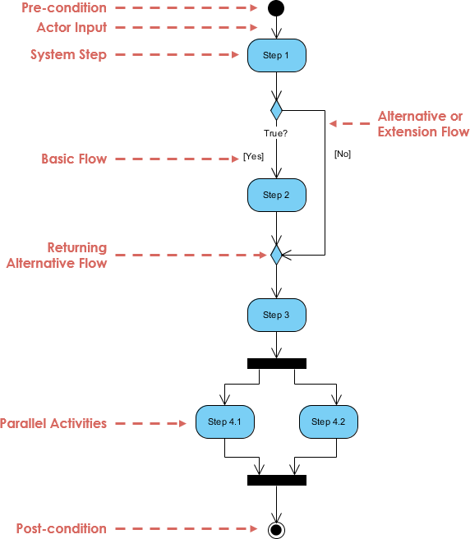
Further Reading: UML activity diagram
Fork
Join
Notes:
What is Activity Diagram? (visual-paradigm.com)

Slide 41
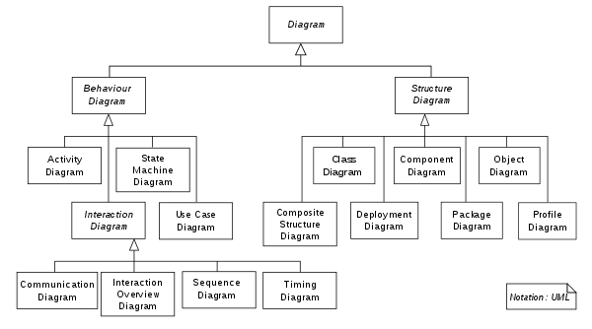
Further Reading: UML
Activity Diagram is a component of UML
The Unified Modeling Language (UML) is a general-purpose, developmental modeling language in the field of software engineering that is intended to provide a standard way to visualize the design of a system.

Slide 42
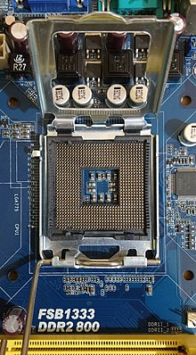
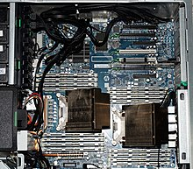
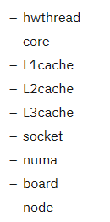

MPI map and bind *
unit of hardware:
HP Z820 Workstation
numa
socket
Notes:
--map-by unit option - IBM Documentation

Slide 43


map-by option
-map-by unit is the most basic of the mapping policies, and makes process assignments by iterating over the specified unit until the process count reaches the number of available slots.
Purpose: control the iteratively distributive pattern of processes

Slide 44

-rank-by
A natural hardware ordering can be created by specifying a smaller unit over which to iterate for ranking
Purpose: control neighbor relationship of processes
Compared to the previous:

Slide 45

-bind-to
A common binding pattern involves binding to cores, but spanning those core assignments over all of the available sockets.
Purpose: control the minimal distance of consecutive processes
Compared to the previous:

Slide 46
Reference
Computer Networking A Top-Down Approach
Chapter 6.6
Introduction to Parallel Computing
Chapter 2.4.1-2.4.5
Tutorial — MPI for Python 3.1.4 documentation (mpi4py.readthedocs.io)
--map-by unit option - IBM Documentation

